Slide 1
DO NOW:
Write the two forms of waves
Write an example of each wave

Slide 2
WAVES- terms and features
19/02/2019

Slide 3
LEARNING INTENTION
BRONZE: SWBAT recognize the different parts of the wave
SILVER: SWBAT define each part of the wave
GOLD: SWBAT calculate the frequency of a wave

Slide 4
KEYWORDS
Amplitude
Wavelength
Frequency
Period

Slide 5
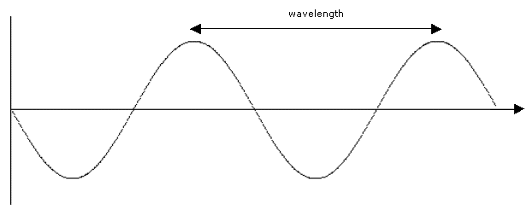
Modelling Waves
Waves are usually represented on a wave diagram as shown below:

Slide 6
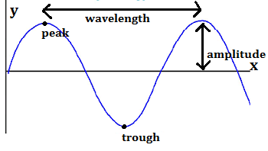
Wavelength= distance from one peak to another
Measured in metres

Slide 7
Amplitude= Displacement of the wave from the original position
Measured in metres

Slide 8
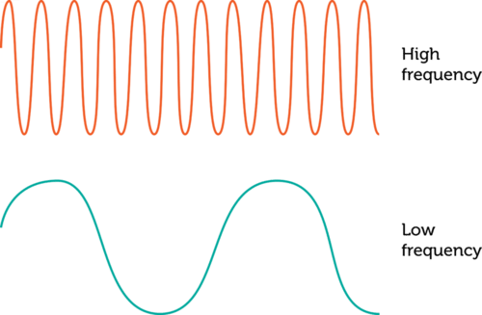
Frequency= amount of waves that pass a fixed point over time
Measured in Hz (1 wave passing a fixed point over time)

Slide 9
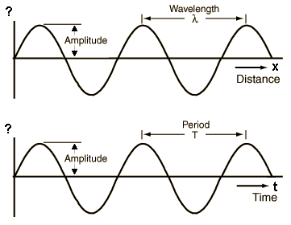
Period= Time taken to complete one period
Measured in seconds

Slide 10
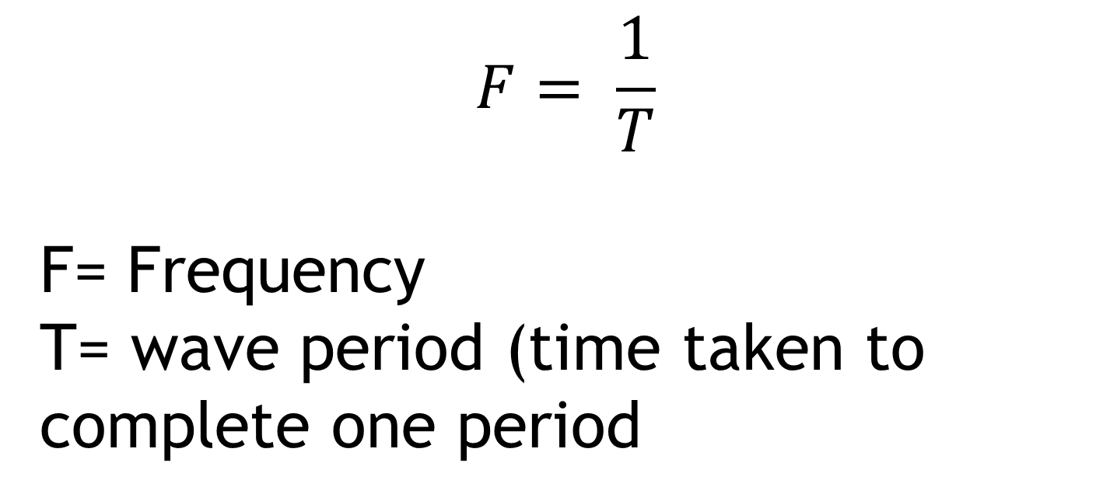
CALCULATING FREQUENCY
$$F= \frac{1}{T}$$
F= Frequency
T= wave period (time taken to complete one period

Slide 11
Questions
What does this represent 2.0 Hz? Frequency or amplitude
Which is measured in metres, wavelength or amplitude
Label a diagram of the different parts of the wave
Write a definition of amplitude, wavelength, wave frequency, wave period
Notes:
GOLD- write down calculate the frequency if time taken for one wave to pass 2.0 seconds and 3 seconds

